Slide 1
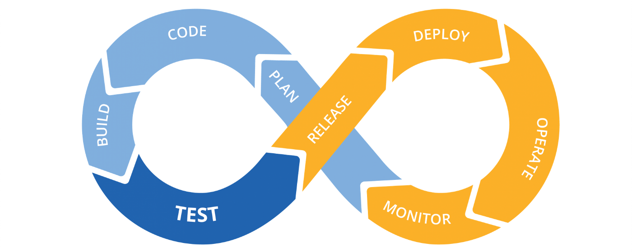
Project CI/CD
Sergii Kapusta
EPAM 2020-2021 winter DevOps

Slide 2
Objective of the project is ci/cd studying
Used tools:
GitHub is a web-based hosting service for version control using Git.
Jenkins is an open source automation server.
Terraform is an open source “Infrastructure as Code” tool.
AWS is a secure cloud services platform, offering compute power, database storage, content delivery and other functionality to help businesses scale and grow.

Slide 3
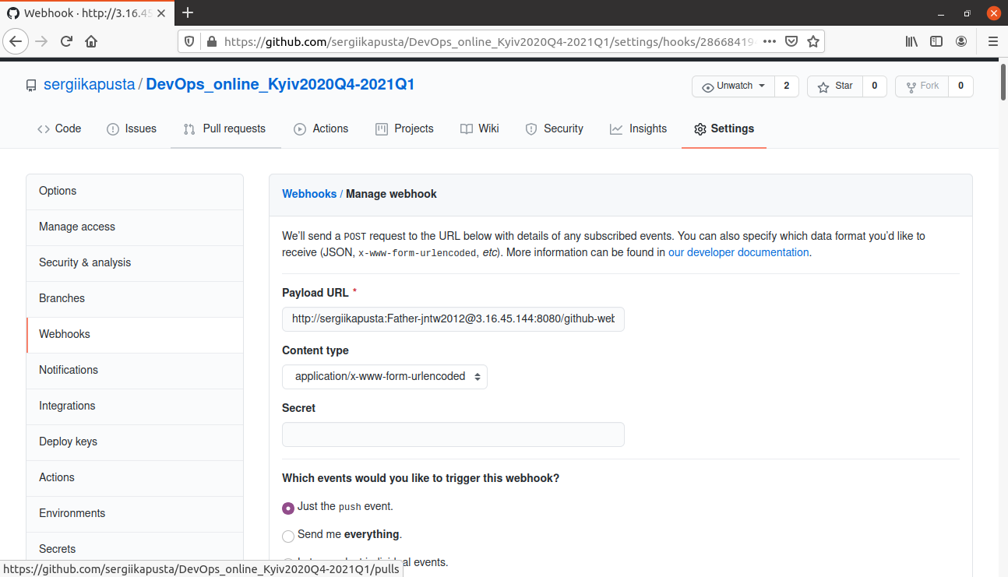
Webhook

Slide 4
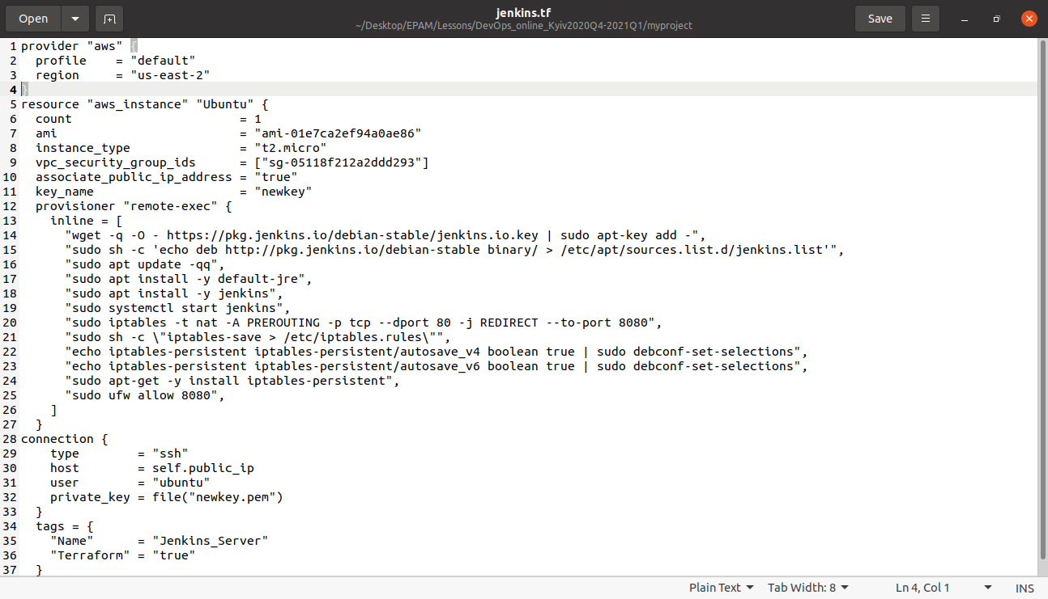
Terraform

Slide 5
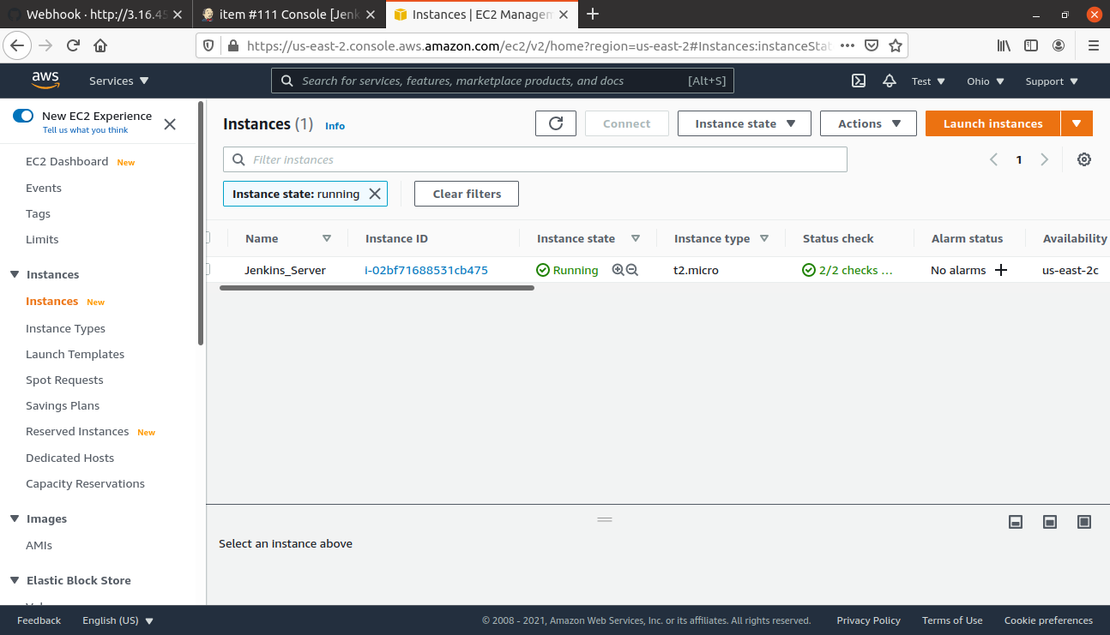
AWS

Slide 6
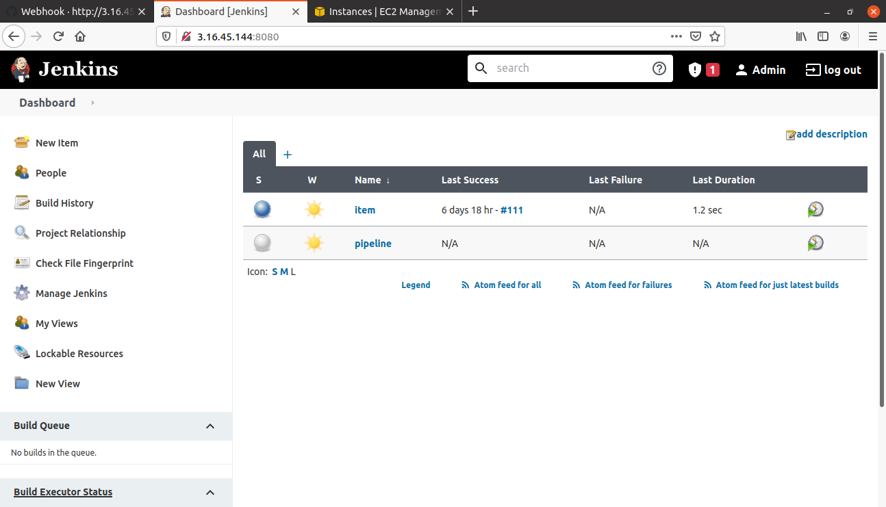
Jenkins

Slide 7
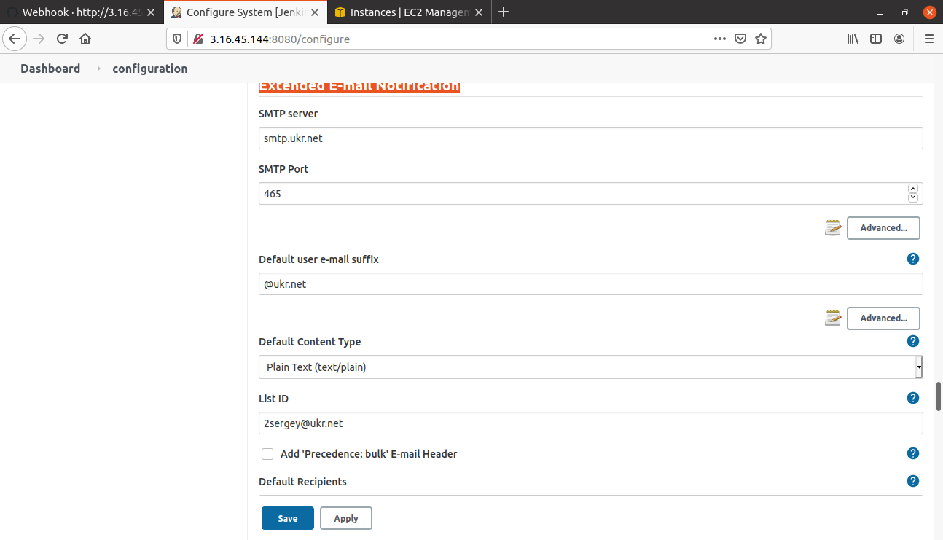
Email Notification

Slide 8
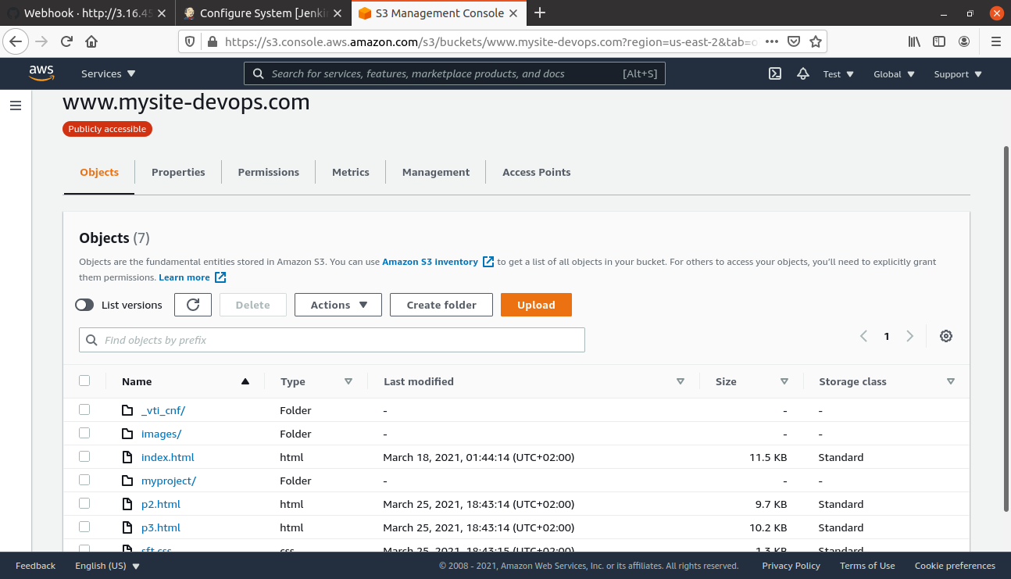
S3

Slide 9
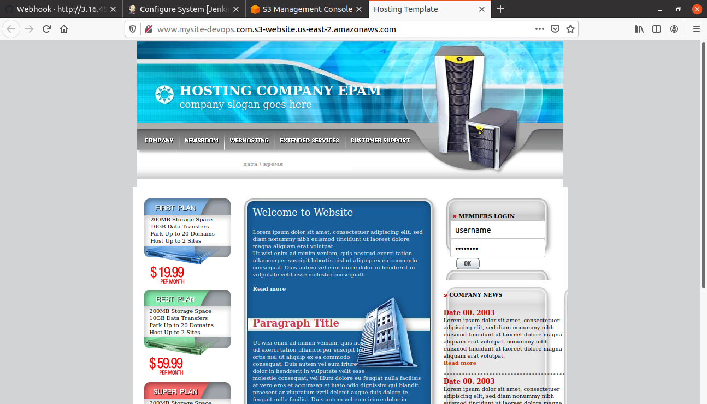
Web site

